Slide 1


Understanding Web Application Workloads and Their Applications:
Systematic Literature Review and Characterization
Roozbeh Aghili, Heng Li, Foutse Khomh

Slide 2
Previous version
Characterizing the Workload Patterns of Web Applications
Roozbeh Aghili, Heng Li, Foutse Khomh

Slide 3





A little of context!
Web application
Workload
Workload pattern
Trace
Time-series clustering

Slide 4
A little of context!
Web application
Workload
Workload pattern
Trace
Time-series clustering
Web applications are software services or applications accessible over the internet through web browsers [1].

Slide 5



A little of context!
Web application
Workload
Workload pattern
Trace
Time-series clustering
Web applications are software services or applications accessible over the internet through web browsers [1].

Slide 6
A little of context!
Web application
Workload
Workload pattern
Trace
Time-series clustering
Workloads refer to tasks, processes, or operations managed by a computer system or a server or a cloud environment at a given time [2].

Slide 7
A little of context!
Web application
Workload
Workload pattern
Trace
Time-series clustering
Workloads refer to tasks, processes, or operations managed by a computer system or a server or a cloud environment at a given time [2].
Examples:
Running web servers
Managing database queries
User requests

Slide 8
A little of context!
Web application
Workload
Workload pattern
Trace
Time-series clustering
Workload patterns are recurring characteristics or behaviors exhibited by an application’s workloads within a specific time interval [3].

Slide 9
A little of context!
Web application
Workload
Workload pattern
Trace
Time-series clustering
Workload patterns are recurring characteristics or behaviors exhibited by an application’s workloads within a specific time interval [3].
Important for tasks such as:
Capacity planning
Resource allocation
Performance optimization

Slide 10
A little of context!
Web application
Workload
Workload pattern
Trace
Time-series clustering
A trace is a systematic and detailed record of events, actions, or data in a specific system used for various purposes, such as debugging and system optimization [4,5].

Slide 11


A little of context!
Web application
Workload
Workload pattern
Trace
Time-series clustering
A trace is a systematic and detailed record of events, actions, or data in a specific system used for various purposes, such as debugging and system optimization [4,5].

Slide 12
A little of context!
Web application
Workload
Workload pattern
Trace
Time-series clustering
Time-series clustering groups time-series data based on similarities and patterns [6]. Time-series is naturally high-dimensional and large in data size [7].

Slide 13
A little of context!
Web application
Workload
Workload pattern
Trace
Time-series clustering
Time-series clustering groups time-series data based on similarities and patterns [6]. Time-series is naturally high-dimensional and large in data size [7].
Improving:
Decision-making
Pattern recognition

Slide 14
Characterizing the Workload Patterns of Web Applications

Slide 15


Characterizing the Workload Patterns of Web Applications
RQ1. What are the existing workload patterns in web application traces?
RQ2. How are different workload patterns distributed in web application traces?

Slide 16
Overview of our study

Slide 17
Overview of our study
Systematic literature search

Slide 18
Overview of our study
Systematic literature search
Selecting web application traces

Slide 19
Overview of our study
Systematic literature search
Selecting web application traces
Preprocessing the traces

Slide 20
Overview of our study
Systematic literature search
Selecting web application traces
Preprocessing the traces
Time-series clustering and analysis

Slide 21
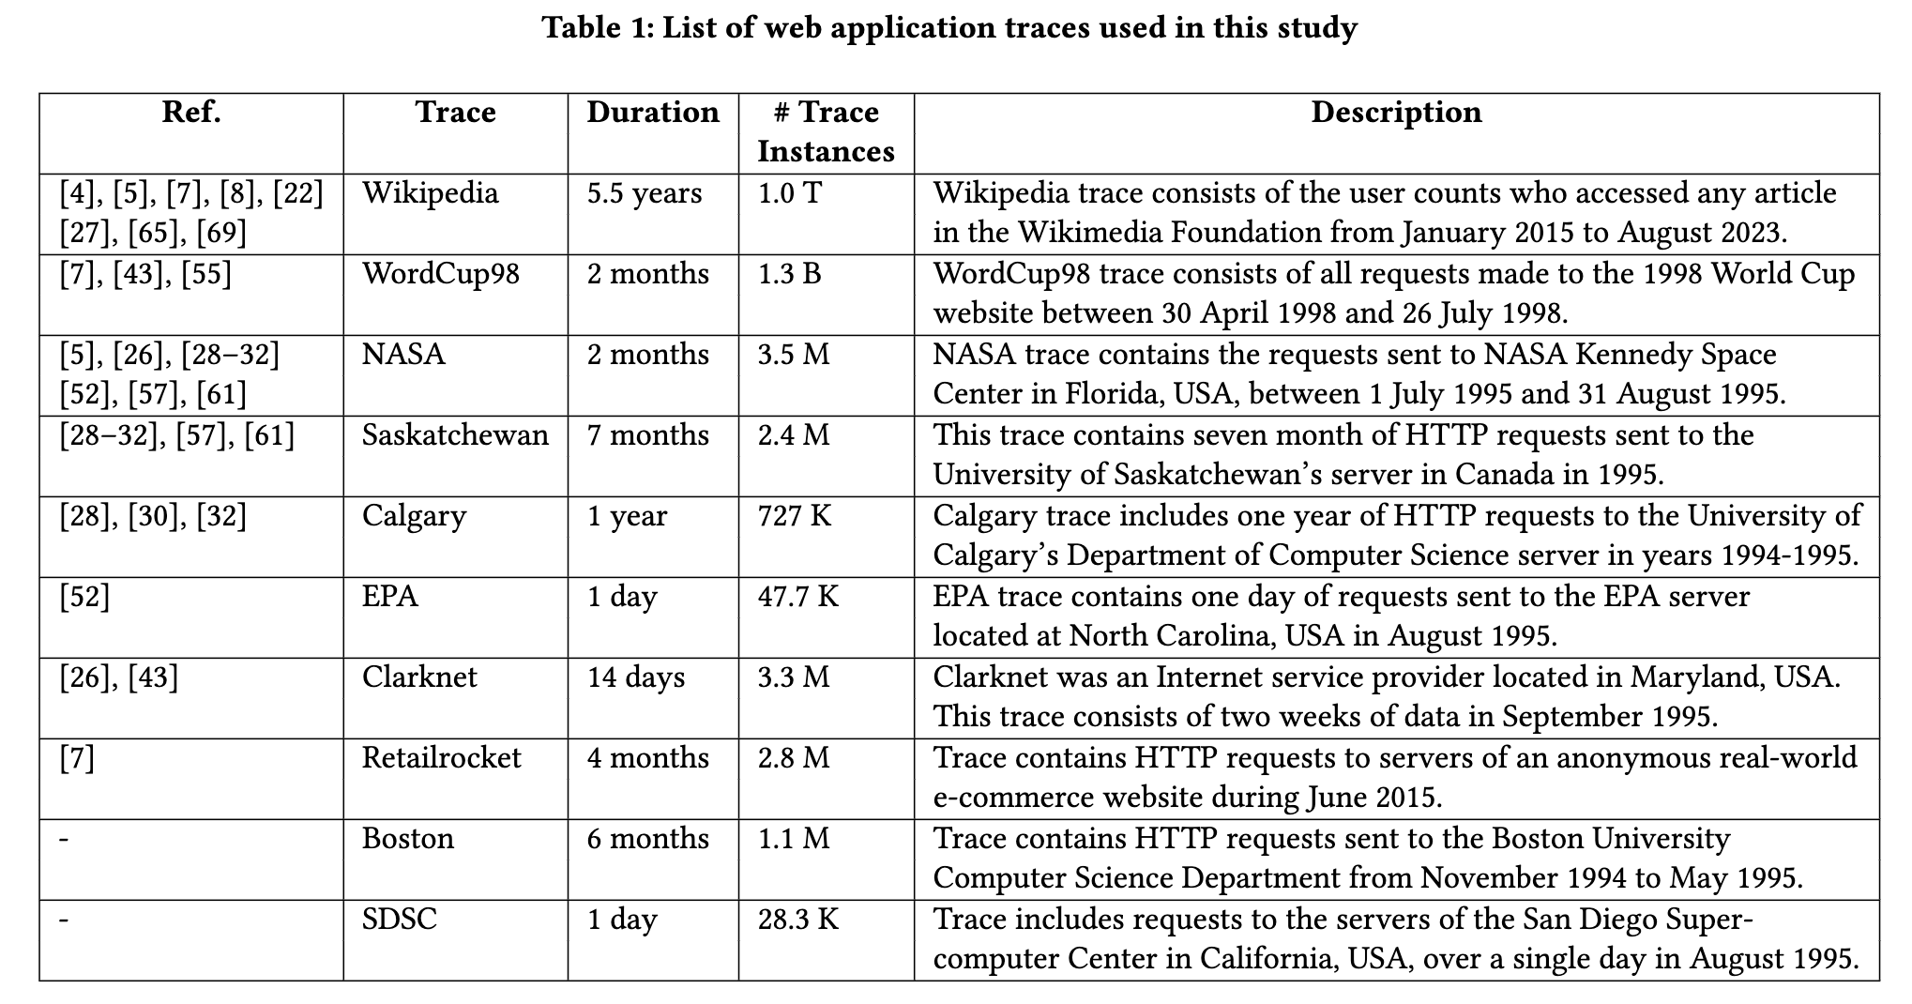
List of web application traces

Slide 22
List of web application traces

Slide 23
List of web application traces

Slide 24
List of web application traces

Slide 25


Preprocessing the traces
Trace | Day | 0 | 1 | 2 | … | 21 | 22 | 23
Boston | 1994-11-21 | 0 | 0 | 0 | … | 0 | 0 | 0
Boston | 1994-11-22 | 0 | 0 | 0 | … | 132 | 40 | 0
Boston | 1994-11-23 | 143 | 664 | 763 | … | 0 | 0 | 0
Trace | Week | M | Tu | W | Th | F | Sa | Su
Boston | 1994-11-27 | 100 | 2984 | 4481 | 1460 | 819 | 0 | 328
Boston | 1994-12-04 | 499 | 304 | 774 | 299 | 523 | 561 | 246
Boston | 1994-12-11 | 398 | 1135 | 623 | 21 | 611 | 19 | 733

Slide 26
Time-series clustering
Aggregation of traces into time intervals ( & )
Normalizing
Clustering
K-means
Silhouette score
K ranging from 1 to 20

Slide 27
Our clustering reveals 4 daily and 2 weekly workload patterns.
D1 (2164 instances)
D2 (156 instances)
W1 (152 instances)
D3 (296 instances)
D4 (502 instances)
W2 (298 instances)

Slide 29
Reviewers’ opinions!
REVIEWER 1
----------- Originality - ----------
SCORE: 3 (reasonably original)
----------- Soundness -----------
SCORE: 3 (some reservations)
--- -------- Relevance -----------
SCORE: 3 (some relevance)
----------- Reproducibility -----------
SCORE: 3 (some information not clear)
----------- Presentation -----------
SCORE: 3 (fair presentation)
----------- Overall evaluation -----------
SCORE: -1 (weak reject)
REVIEWER 2
----------- Originality -----------
SCORE: 1 (not at all original)
----------- Soundness -----------
SCORE: 3 (some reservations)
----------- Relevance -------- ---
SCORE: 2 (very little relevance)
----------- Reproducibility -----------
SCORE: 3 (some information not clear)
------- ---- Presentation -----------
SCORE: 4 (good presentation)
----------- Overall evaluation -----------
SCORE: - 2 (reject)
REVIEWER 3
----------- Originality -----------
SCORE: 2 (somewhat original)
----------- Soundness -----------
SCORE: 3 (some reservations)
----------- Relevance - ----------
SCORE: 4 (relevant)
----------- Reproducibility -----------
SCORE: 3 (some information not clear)
-- --------- Presentation -----------
SCORE: 4 (good presentation)
---------- Overall evaluation --------- --
SCORE: -1 (weak reject)

Slide 30
Reviewers’ opinions!
REVIEWER 1
Most of the datasets analyzed in the paper are very old (almost 30 years old), thus they do not take into account the big changes occurred to the HTTP protocol and web technologies in recent years. Since these changes might significantly affect the patterns, the results presented in the paper as well as the conclusions drawn might be rather unrealistic. This is a major weakness of this paper.
Despite the very large number of references presented in the paper, authors do not clearly identify the 19 research articles used for selecting the datasets being analyzed. In addition, the paper does not justify the choice of the time frame used for the literature review.
The paper should be shortened by removing repeated concepts and the well-known definitions given in the background section.

Slide 31
Reviewers’ opinions!
REVIEWER 2
The authors argue that while there has been lots of research on cloud workload characterization, there has not been much on web application workload characterization. I am not convinced that these two types of workloads are very different (since almost all web applications run in the cloud). Also, I am not convinced that we currently have that many issues in generating workloads for web applications...
Looking at the patterns in Figure 4 and 5, they are quite predictable (and well-known from eg work on SaaS workload characterization). For example, D4 ​​seems to show websites that are used mostly during working hours and D2 shows websites that are used mostly during evening/nightly hours.
Another major concern that I have is that most of the studied traces are very old (eg, World Cup 98 and the datasets hosted on Lawrence Berkeley National Laboratory are from 1995). This is ancient for web applications, and I think the distribution of the patterns may look very different these days. I don't see much point in extracting patterns from such old data in an area that has changed so much. So while some of the analysis is novel, I don't think we will be able to leverage the results into generating better workloads.

Slide 32
Reviewers’ opinions!
REVIEWER 3
the list of web application traces includes quite old data and it results unbalanced since two datasets deal with one day only, the weekly analysis cannot be performed.
the number of trace instances requires some further elaboration, Table 1 shows a column with '# Trace Instances' whereas Figure 4 reports a much lower number of instances, the match with respect to the analyzed datasets is missing.
the findings seem well-known, all workload patterns denote the dynamic nature of web application workloads that was already the state-of-the-art (prediction and/or optimization) approaches, the quantitative estimation of climbing and descending curves is specific to each web application , hence it is unclear the usefulness of aggregating data.

Slide 33
Previous version
Characterizing the Workload Patterns of Web Applications
RQ1. What are the existing workload patterns in web application traces?
RQ2. How are different workload patterns distributed in web application traces?

Slide 34

Previous version
Characterizing the Workload Patterns of Web Applications
RQ1. What are the existing workload patterns in web application traces?
RQ2. How are different workload patterns distributed in web application traces?
Current version
Understanding Web Application Workloads and Their Applications
RQ1. What are the applications of web application workloads in
existing works?
RQ2. What are the existing patterns in web application workloads?

Slide 35
Previous version
Overview of our study

Slide 36
Previous version
Overview of our study
Current version

Slide 37
Previous version
Overview of our study
Current version

Slide 38
Previous version
Overview of our study
Current version

Slide 39
Previous version
Overview of our study
Current version

Slide 40
Previous version
List of web application traces

Slide 41
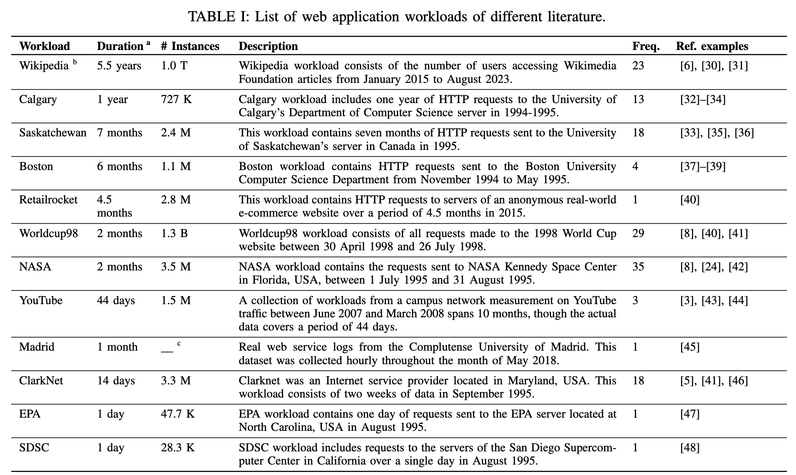
Previous version
List of web application traces
10 datasets
Current version
12 datasets

Slide 42
Previous version
Daily and weekly workload patterns

Slide 43
Previous version
Daily and weekly workload patterns
Current version

Slide 44
Current version
Because of our systematic literature review
Cumulative number of papers per objective over the years

Slide 45
Current version
Because of our systematic literature review
Cumulative number of papers per objective over the years
Comparison of literature publication years and corresponding workload dataset years
Notes:
Over 82% of articles published in 2015 and later rely on datasets that were published in 2000 or earlier.

Slide 47
References
Mehdi Jazayeri. 2007. Some trends in web application development. In Future of Software Engineering (FOSE’07). IEEE, 199–213.
Domenico Ferrari, Giuseppe Serazzi, and Alessandro Zeigner. 1983. Measurement
and tuning of computer systems. (No Title) (1983).
Waheed Iqbal, Abdelkarim Erradi, and Arif Mahmood. 2018. Dynamic workload
patterns prediction for proactive auto-scaling of web applications. Journal of
Network and Computer Applications 124 (2018), 94–107.
Jing Guo, Zihao Chang, Sa Wang, Haiyang Ding, Yihui Feng, Liang Mao, and
Yungang Bao. 2019. Who limits the resource efficiency of my datacenter: An anal-
ysis of alibaba datacenter traces. In Proceedings of the International Symposium
on Quality of Service. 1–10.
Charles Reiss, Alexey Tumanov, Gregory R Ganger, Randy H Katz, and Michael A
Kozuch. 2012. Heterogeneity and dynamicity of clouds at scale: Google trace
analysis. In Proceedings of the third ACM symposium on cloud computing. 1–13.
Saeed Aghabozorgi, Ali Seyed Shirkhorshidi, and Teh Ying Wah. 2015. Time-
series clustering–a decade review. Information systems 53 (2015), 16–38.
Eamonn Keogh and Shruti Kasetty. 2002. On the need for time series data mining
benchmarks: a survey and empirical demonstration. In Proceedings of the eighth
ACM SIGKDD international conference on Knowledge discovery and data mining.
102–111.

