Slide 1
Uftrace update Related to Ciena Contributions
Author: François Tétreault
Published 5/30/2024

Slide 2
Table of Content
Why: Existing uftrace workflow
How: “dynamic tracing” research objectives (2016)
What: Productize student prototypes
(plus, other enhancements)
Status: Project updates
Thank you!

Slide 3
Why

Slide 4
Why: Existing uftrace workflow
Launch program from uftrace providing desired options and what needs to be patched.
Uftrace collects a trace in "uftrace binary format".
Program terminates.
Collected trace is available for analysis.

Slide 5
Why: Existing uftrace workflow
Launch program from uftrace providing desired options and what needs to be patched.
Uftrace collects a trace in "uftrace binary format".
Program terminates.
Collected trace is available for analysis.
Wow! uftrace
is very cool!

Slide 6
Why: Existing uftrace workflow
Launch program from uftrace providing desired options and what needs to be patched.
Uftrace collects a trace in "uftrace binary format".
Program terminates.
Collected trace is available for analysis.
Let’s help with
uftrace
capabilities.

Slide 7
How
Researcher

Slide 8
How: “dynamic tracing” research objectives (2016)
Instrument any C/C++ code-generated binary, regardless of the compilation method employed.
Enable instrumentation and tracing at runtime.
Develop dynamic instrumentation methods for x86 and x64.
Instrument entry and exit of every function.
Strive for maximum coverage (close to 100%).
Integrate with LTTng and Trace Compass using CTF.
Provide capability as a generic library.

Slide 9
How: “dynamic tracing” research objectives (2016)
Instrument any C/C++ code-generated binary, regardless of the compilation method employed.
Enable instrumentation and tracing at runtime.
Develop dynamic instrumentation methods for x86 and x64.
Instrument entry and exit of every function.
Strive for maximum coverage (close to 100%).
Integrate with LTTng and Trace Compass using CTF.
Provide capability as a generic library.
Those are my
research objectives!?

Slide 10
How: “dynamic tracing” research objectives (2016)
Instrument any C/C++ code-generated binary, regardless of the compilation method employed.
Enable instrumentation and tracing at runtime.
Develop dynamic instrumentation methods for x86 and x64.
Instrument entry and exit of every function.
Strive for maximum coverage (close to 100%).
Integrate with LTTng and Trace Compass using CTF.
Provide capability as a generic library.
I’m up to the task, let’s do it!

Slide 11
What

Slide 12
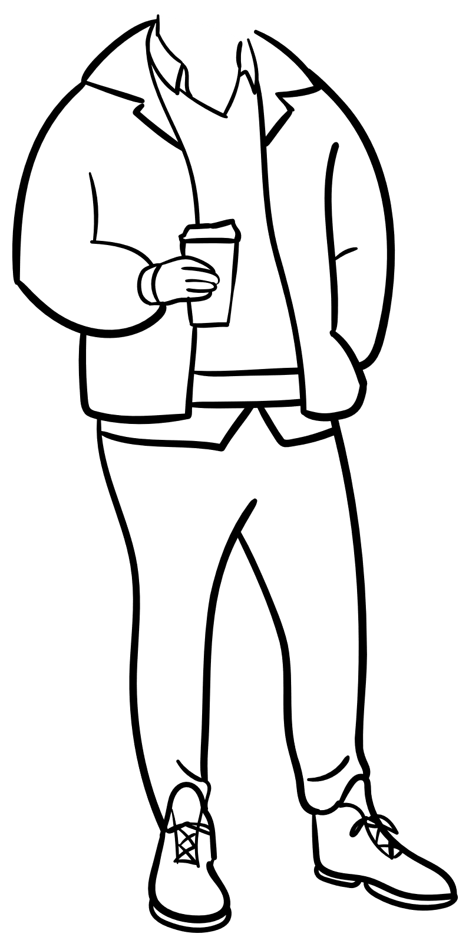
What
Jason

Slide 13
What
Jason
Clément

Slide 14
What: Productize student prototypes (plus, other enhancements)
Add support for "Dynamic Tracing" on five processor architectures, including:
x86 (32-bit)
x64 (64-bit)
ARM (64-bit)
PowerPC (32-bit)
PowerPC (64-bit)
Enable tracing of already running programs using a client/server approach.
(with uftrace client injection)
Customize simple and complex tracing parameters at runtime, such as:
Filters for stack depth, function names, and time of day.
Trigger actions based on specific conditions.
Collect function arguments and return values.

Slide 15
What: Productize student prototypes (plus, other enhancements)
Add support for "Dynamic Tracing" on five processor architectures, including:
x86 (32-bit)
x64 (64-bit)
ARM (64-bit)
PowerPC (32-bit)
PowerPC (64-bit)
Enable tracing of already running programs using a client/server approach.
(with uftrace client injection)
Customize simple and complex tracing parameters at runtime, such as:
Filters for stack depth, function names, and time of day.
Trigger actions based on specific conditions.
Collect function arguments and return values.
I love it!

Slide 16
What: Productize student prototypes (plus, other enhancements)
Initiate new tracing sessions with start and stop capability.
Collected traces from running programs.
Add support for LTTng in order to collect traces in CTF format.
Implement general improvements to enhance functionality.
Integrate uftrace into Ciena workflows.
Contribute to uftrace open-source project.

Slide 17
What: Productize student prototypes (plus, other enhancements)
Initiate new tracing sessions with start and stop capability.
Collected traces from running programs.
Add support for LTTng in order to collect traces in CTF format.
Implement general improvements to enhance functionality.
Integrate uftrace into Ciena workflows.
Contribute to uftrace open-source project.
I love it too!

Slide 18
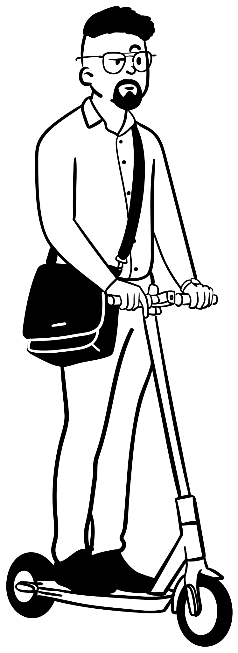
Status
Manager

Slide 19
Status: Project updates
Development inside Ciena is 80% to 90% done.
Available on some of our products.
Rolling out to more products in-progress.
Upstreaming to uftrace project is on-going.
Thank you to Namhyung Kim, Honggyu Kim, and the extended uftrace team!

Slide 20
Status: Project updates
Development inside Ciena is 80% to 90% done.
Available on some of our products.
Rolling out to more products in-progress.
Upstreaming to uftrace project is on-going.
Thank you to Namhyung Kim, Honggyu Kim, and the extended uftrace team!
Good job!

Slide 21
Status: Project updates
Development inside Ciena is 80% to 90% done.
Available on some of our products.
Rolling out to more products in-progress.
Upstreaming to uftrace project is on-going.
Thank you to Namhyung Kim, Honggyu Kim, and the extended uftrace team!
But we are not done.

Slide 22
Thank you to:
Everyone at the Dorsal lab (including past students),
Ciena Management (VPs, directors, and so on),
Namhyung Kim, and Honggyu Kim, and
Everyone else for your continuous support!

