Slide 1
Baseliner: A Plugin-Oriented, Hardware-Agnostic GPU Benchmarking Library
Come Eyraud, Maxime Lamothe

Slide 2
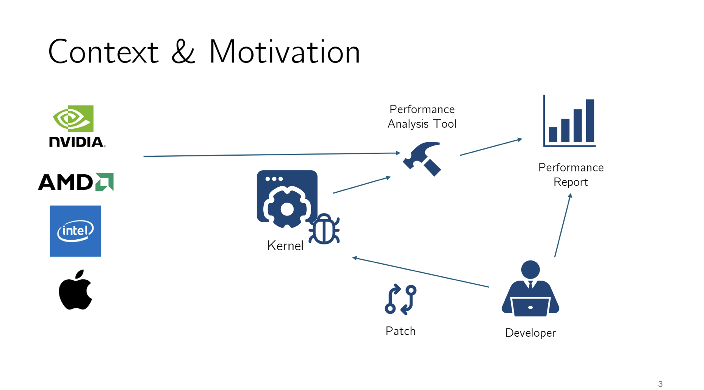
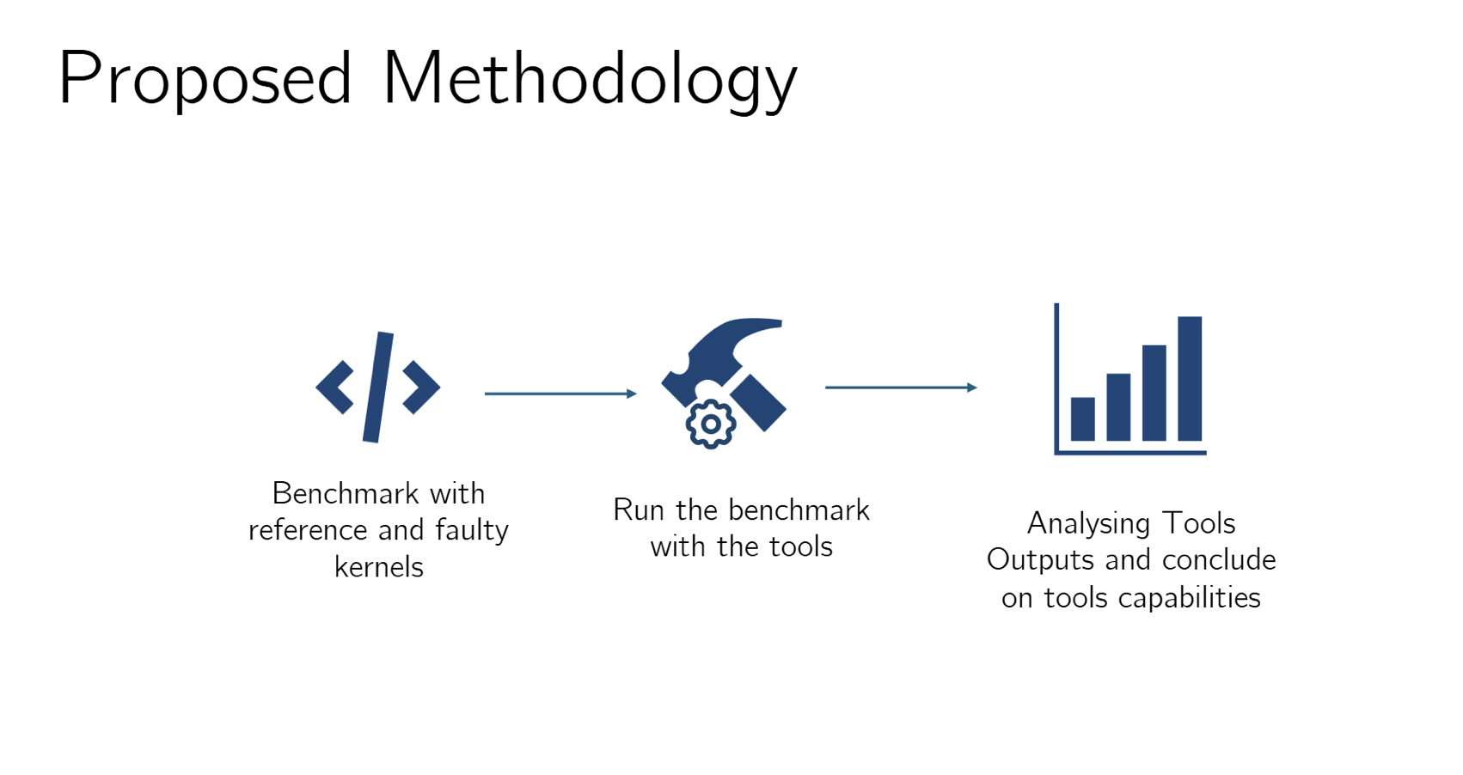
Context (Recap)

Slide 3
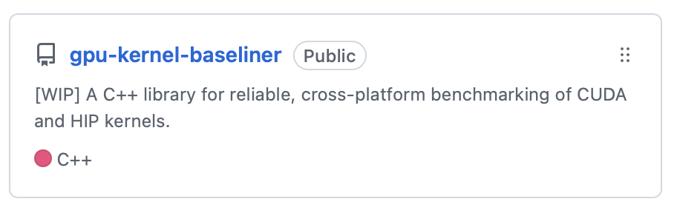
Designing a Benchmarking Tool
We propose Baseliner, a backend agnostic GPU kernel benchmarking library
github.com/comeyrd/gpu-kernel-baseliner
Goal :
Define a standard Kernel definition interface
Separate benchmarking logic, kernel logic and backend logic
Provide developers with built-in proven optimal setup for lightweight, accurate and reproducible performance measures.
Library for both Benchmarking and Regression Tests needs.
Highly customizable and plugin oriented (future proof)
Notes:
Futur proof

Slide 4
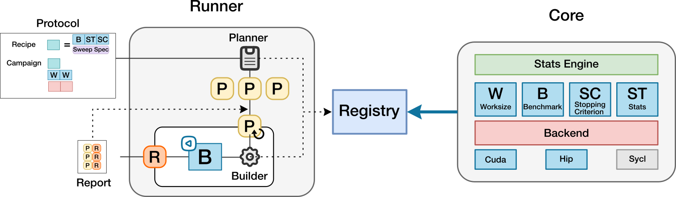
The Baseliner Architecture

Slide 5
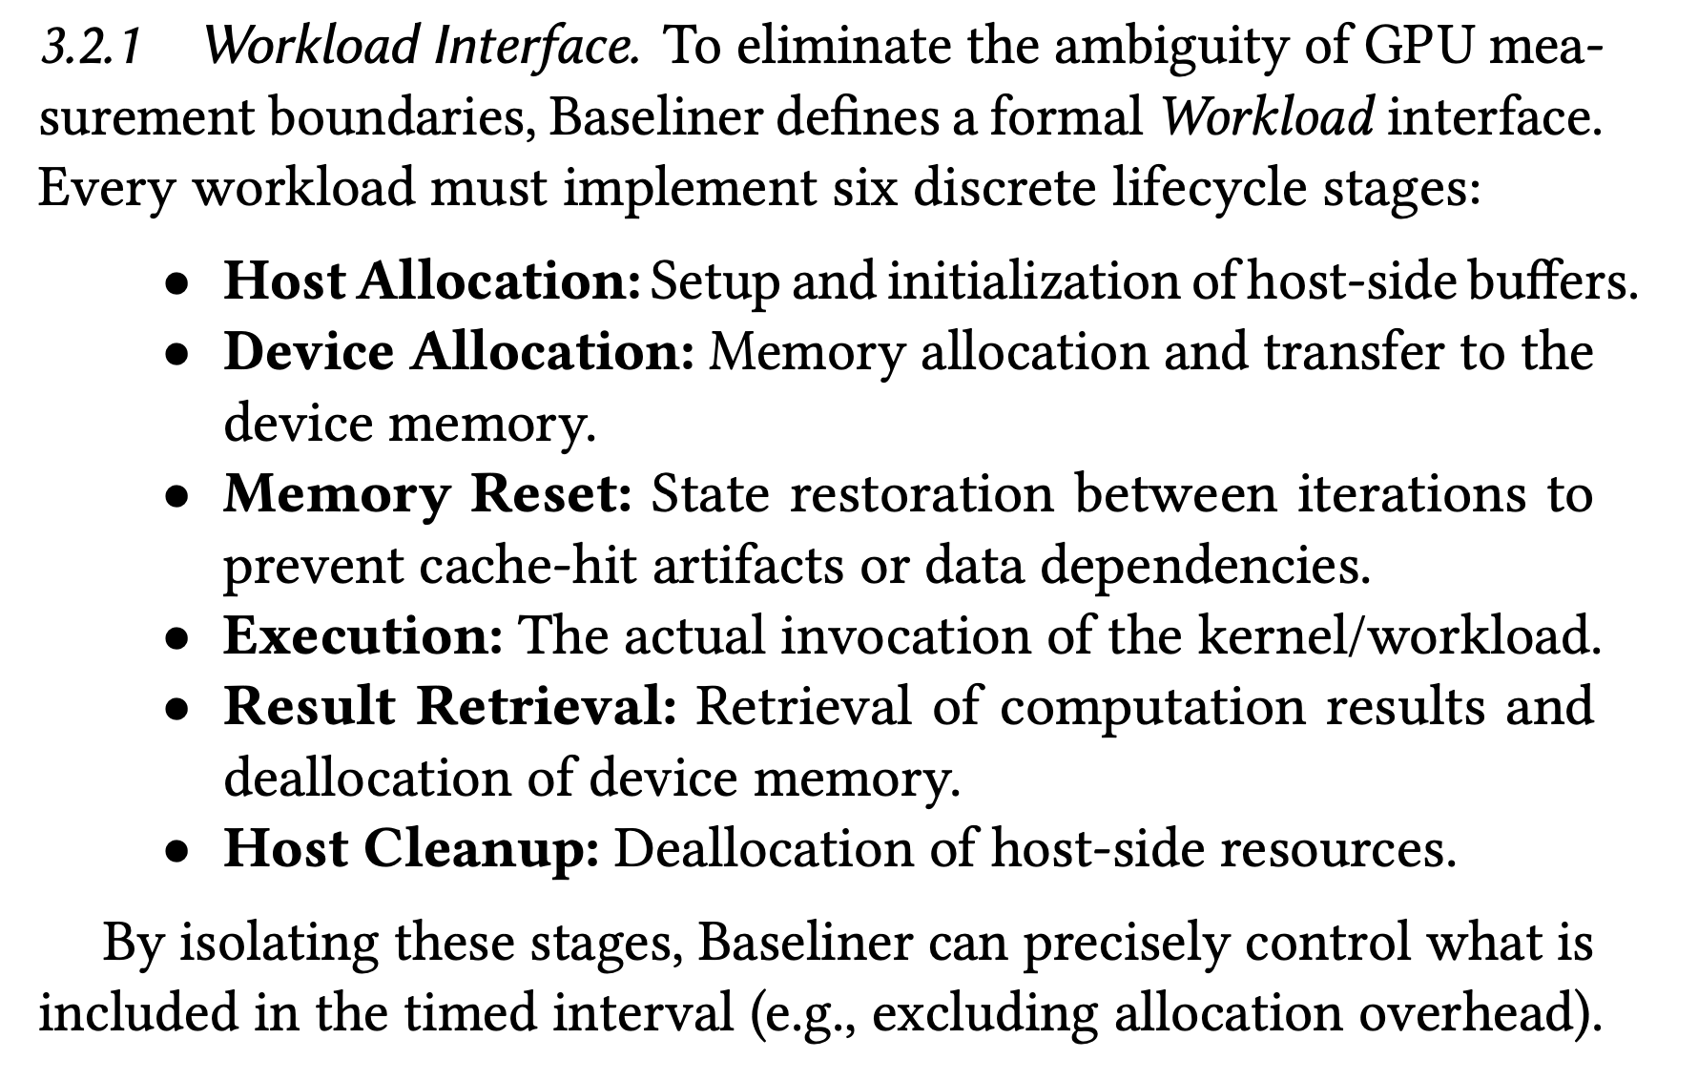
The Benchmark Architecture and Workload interface

Slide 6


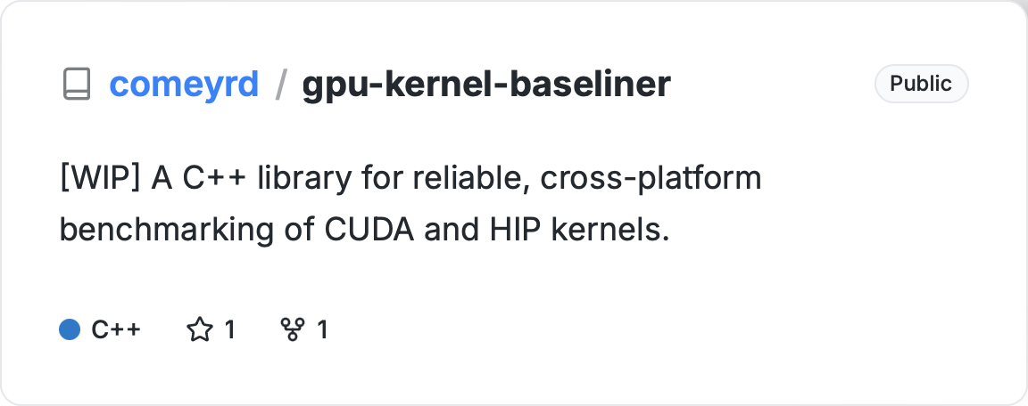
Links
Everything is open source
Replication
package

