Slide 1



Trigger-based Dynamic Tracing
Dynamic
Dynamic
Ali Entezari – July 10, 2026
Supervisiors: Prof. Heng Li, Mohammad Nassiri

Slide 2

Condition-based CFG Tracer (Recap)
RECAP
  Softwere-based (Libpatch)
  2- layered probe tracing strategy
  Low overhead on standby mode

Slide 3
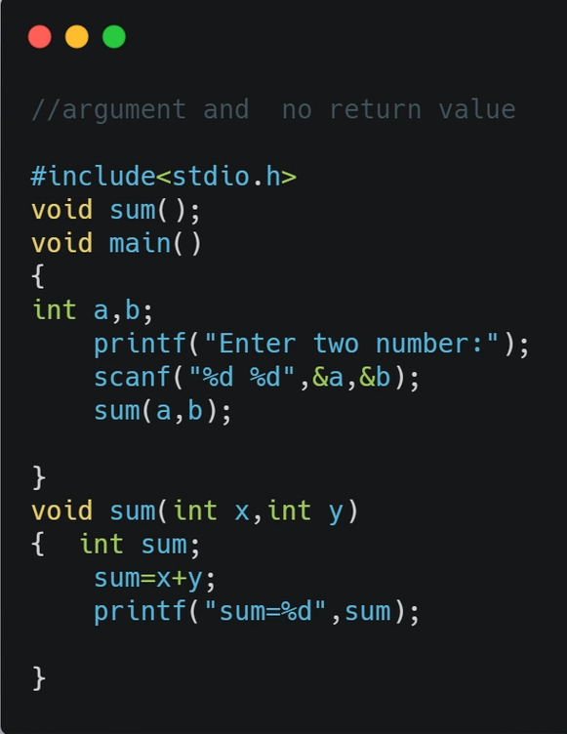
2-Layered Probe Tracing
RECAP
Probe type 1: (Trigger check)
- Hooked to function entry
Checks function args for anomaly detection
Low overhead
Probe type 2: (Tracer)
Hooked to target address
Does tracing
Overhead depends on frequency

Slide 4
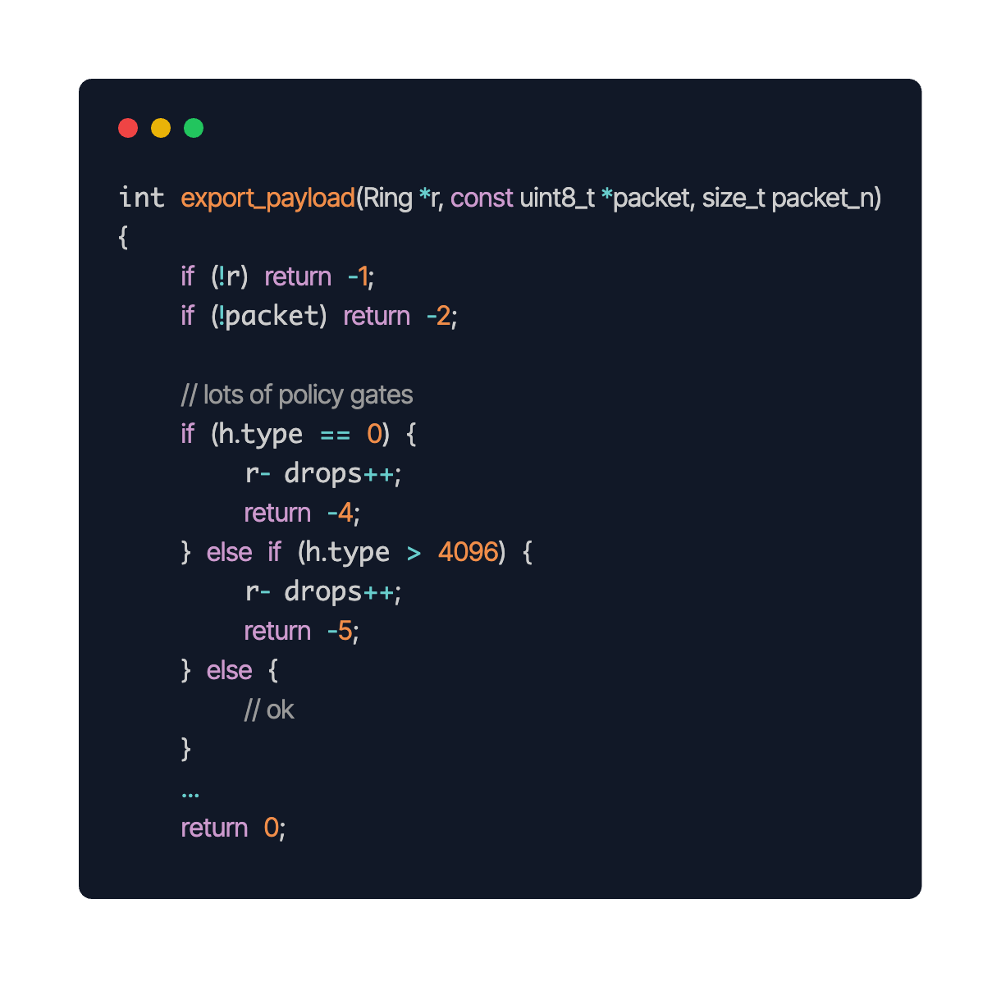
2-Layered Probe Tracing Use Case: DCFG
RECAP
Probe type 1: (Trigger check)
Probe type 2: (CFG Tracer)
Target: Jump instructions
Usage: Dynamic CFG Tracer

Slide 5
Motivation
RECAP
Persistent tracing → runtime overhead
Affects timing & reliability (time-sensitive systems)
Most execution = steady state → low tracing value
Anomalies are rare
Tracing is useful when issues occur
Motivation

Slide 6
Trigger-Based Dynamic Tracing
RECAP
Generic Trigger
eBPF
Inisde function arg range check
User (terminal, python, web)
Etc.
Stage 1
Motivation
Generic Tracer
Libpatch
LTTng
perf
uftrace, strace, etc.
Stage 2
Analysis
Visualization: e.g. Trace Compass
AI-powered
LLM / ML
we can use trigger info!
SOLUTION
Stage 3

Slide 7







WYVERN: Trigger-Based Dynamic Tracing
RECAP
WYVERN
Generic Trigger
eBPF
Inide function arg range check
User (terminal, python, web)
Etc.
Generic Trigger
eBPF
Inide function arg range check
User (terminal, python, web)
Etc.
Internal LibPatch Trigger
- Real Time user space Trigger
External Signal-Based Trigger
- Generic Trigger
Motivation
perf
Generic Tracer
Libpatch
LTTng
perf
uftrace, strace, etc.
Generic Tracer
Libpatch
LTTng
perf
uftrace, strace, etc.
Internal LibPatch Tracer
- Real Time user space Tracer
uftrace
External Tracers
- Generic Trigger
strace
SOLUTION

Slide 8

Architecture
if not attached to PID 42452 :
attach CFG tracer
else:
enable tracing
# We only want to trace this specific app
$PID $TID action
$ signal_sender 42452 42453 1
BPFtrace
syscall count
CFG
Tracer
Wyvern signal sender
shared memory
BPFtrace
Thread block check
42452 42453 1
New event
LTTng
action=1 => wyvern tracer
Python
Script
Wyvern Daemon
Perf
GitHub

Slide 9
Architecture
# We want to do a quick system-wide monitoring
BPFtrace
syscall count
CFG
Tracer
$PID $TID action
$ signal_sender 32432 32433 0
Wyvern signal sender
1 - dump LTTng traces on disk
(what caused trigger to fire)
2- record next 60s
(follow-up monitoring)
shared memory
BPFtrace
Thread block check
42452 42453 1
32432 32433 0
New event
LTTng
action=0 => LTTng kernel
Python
Script
Wyvern Daemon
Perf
GitHub

Slide 10
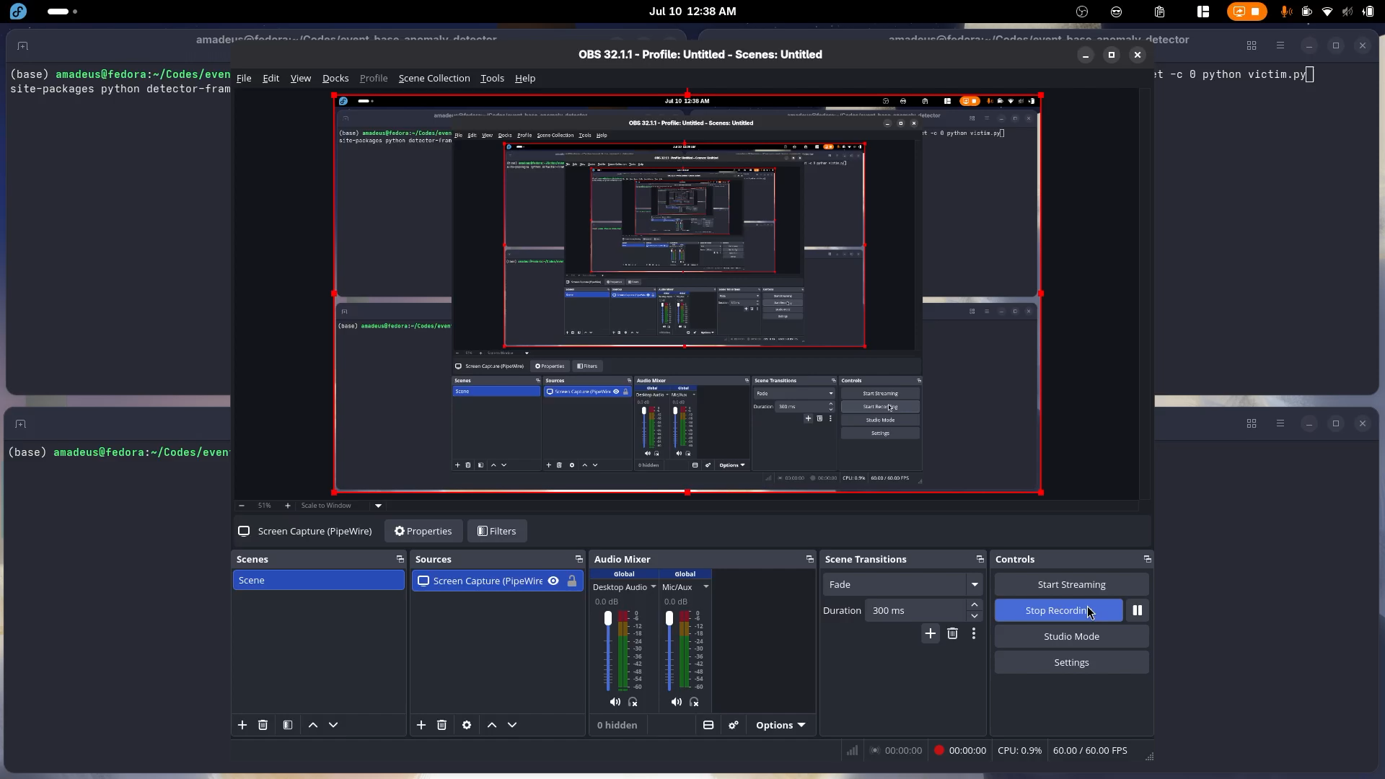
Video Demo

Slide 11
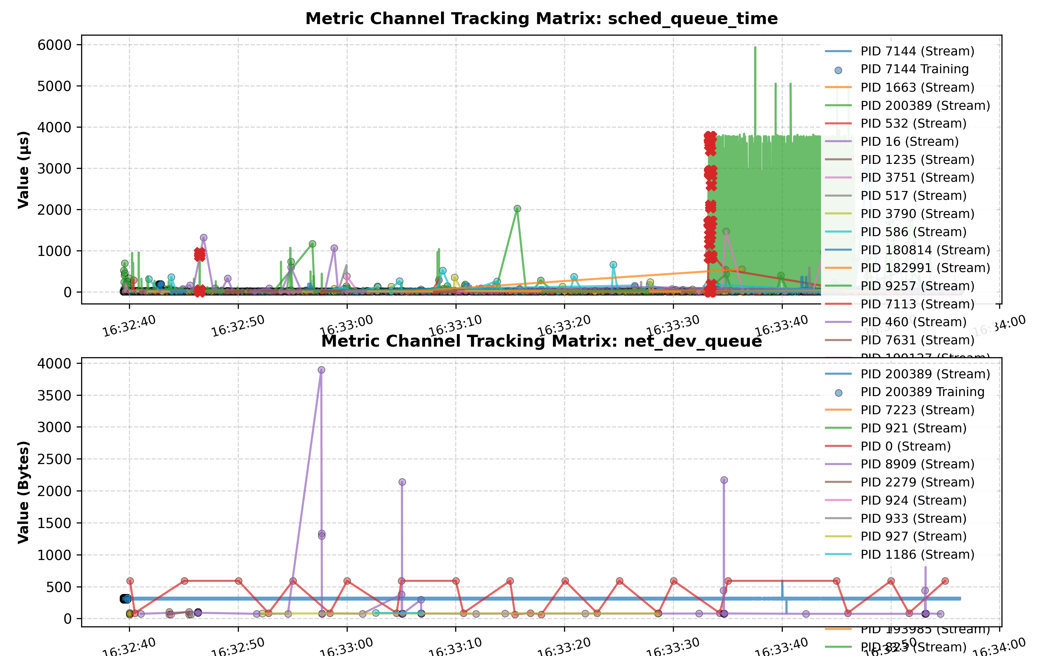
Trace Analysis

Slide 12
Thanks / Q?

