Slide 1


Low-Cost and High-Performance Log Parsing
Qiaolin (Isabelle) Qin
Moose Lab
Hello

Slide 2
Motivation: Log Parsing
“A crucial step of automated log analysis is to parse the semi-structured log messages into structured log events. ” (He et al., 2021)
Messages in the same cluster -> denote the same system event
Statistic-based parsing: use statistical heuristics (e.g., frequency)
Semantic-based parsing: use language models (e.g., ChatGPT)
Original Message | jk2 init() Found child 8766 in scoreboard slot 12
Event Template | jk2 init() Found child <*>in scoreboard slot <*>

Slide 3
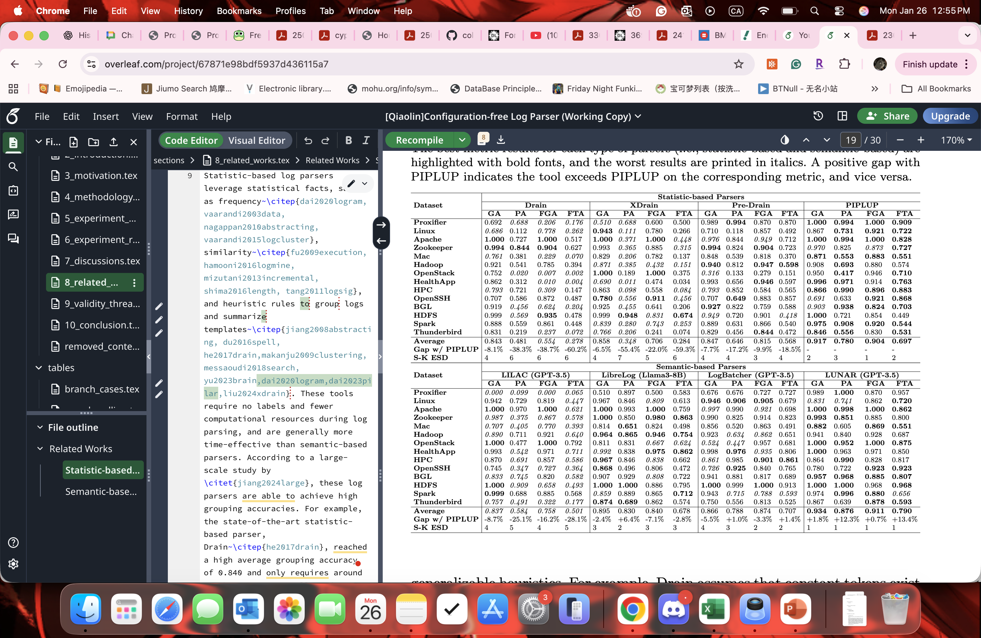
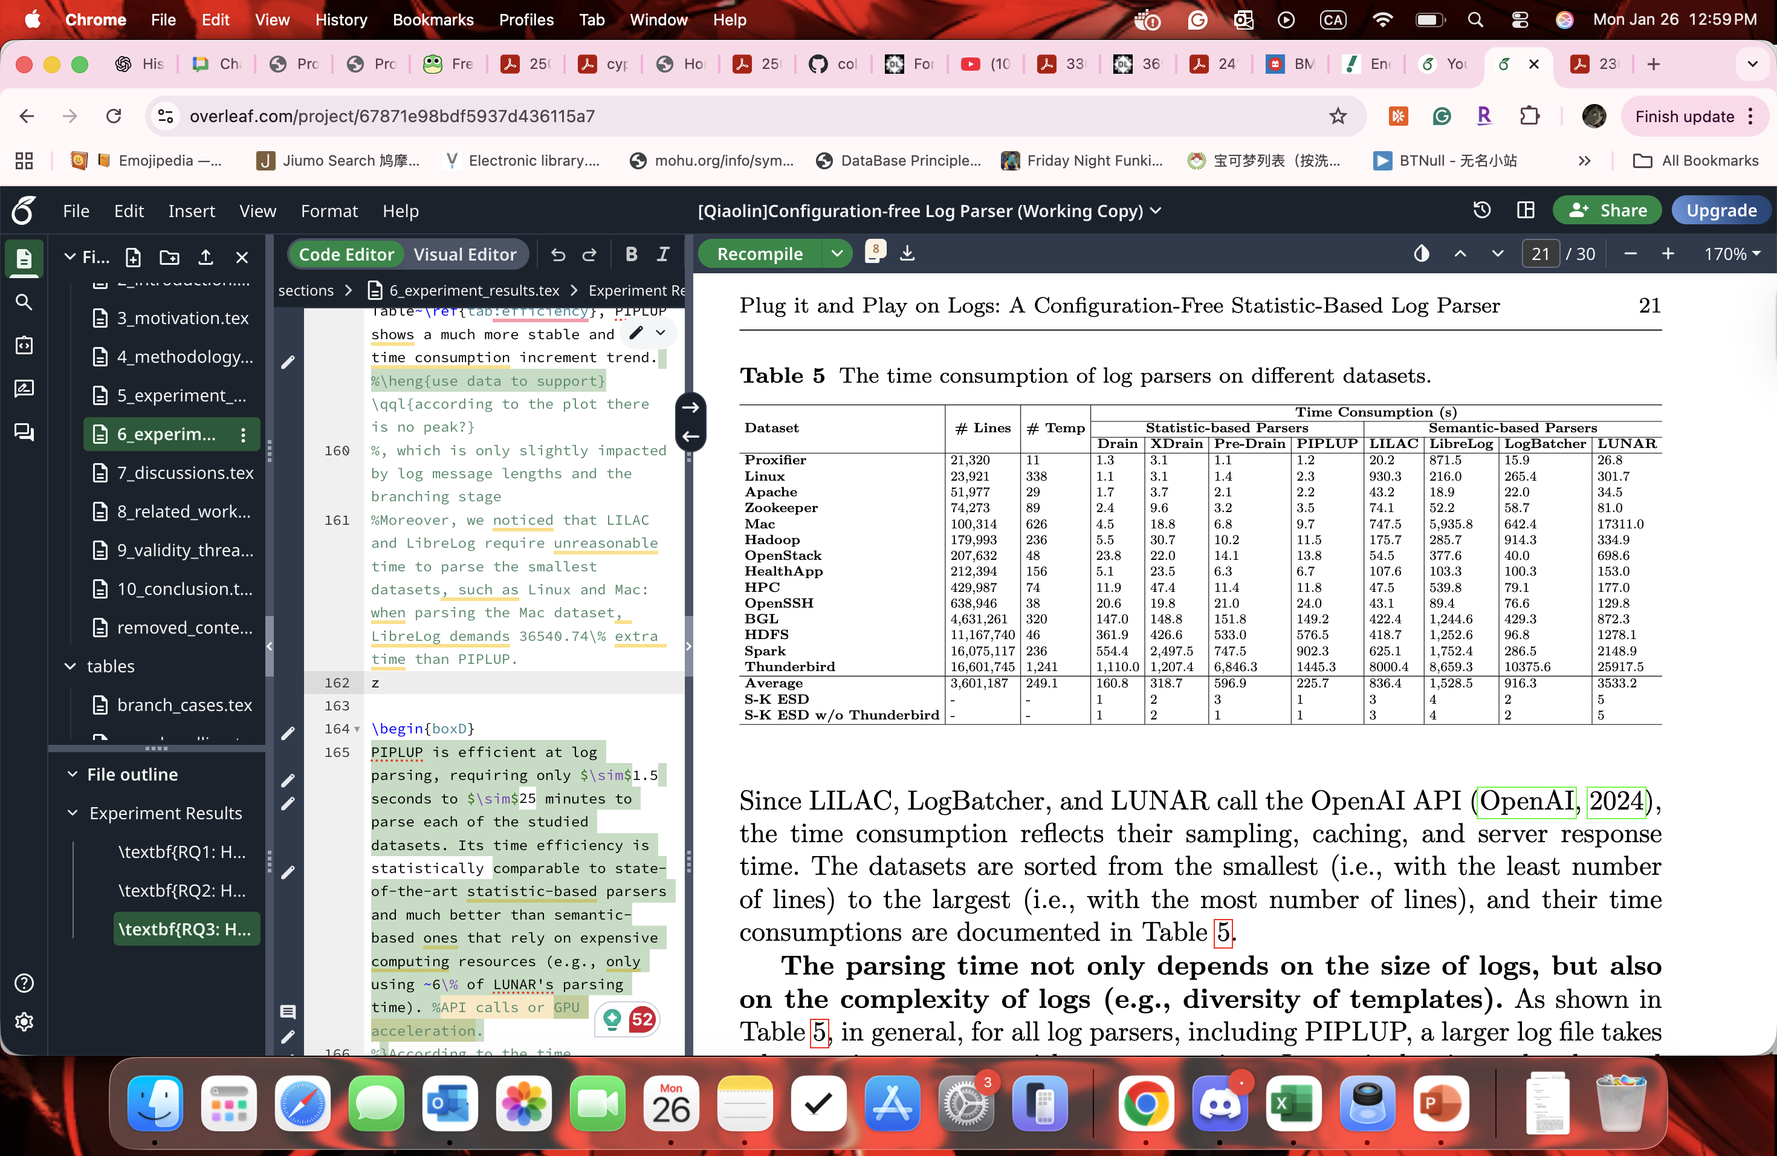
Motivation: Limitations in Log Parsing
Imbalanced efficiency (scalability) and effectiveness (accuracy)
Many require data-dependent configuration
Effectiveness
Efficiency
Parsing Time (s)

Slide 4
Meet PIPLUP
PIPLUP: Plug It and Play on Logs: configUration-free Parser
Enables “plug-and-play” feature on new logs
Balanced efficiency and effectiveness log parsing
Privacy-preserving
You don’t have to pay OpenAI or buy a good GPU for log parsing anymore!

Slide 5
Heuristics
Length-based similarity thresholds
Variable number is correlated to message lengths
Frequency-based Constant Identification
High-frequency tokens tend to be constants
In-cluster Event Branching
Similarity-based separation may incorrectly merge structurally similar but semantically different events
Overlapping Templates Merging
A same event may have log messages in different lengths

Slide 6
Heuristics
Length-based similarity thresholds
Variable number is correlated to message lengths
Examples from the Spark dataset
Message | Len. | Exp. Sim. | Template
attempt_201706092018_0024_m_000043_1128: Committed | 2 | 0.5 | <*>: Committed
attempt_201706092018_0024_m_000040_1125: Committed
Running task 0.0 in stage 0.0 (TID 0) | 8 | 0.625 | Running task <*> in stage <*> (TID <*>)
Running task 2.0 in stage 0.0 (TID 2)

Slide 7
Heuristics
In-cluster Event Branching
Similarity-based separation may incorrectly merge structurally similar but semantically different events
Examples from the HealthApp dataset
Template | Length | Similarity
onReceive action: android.intent.action.SCREEN_OFF | 2 | 0.5
onReceive action: android.intent.action.SCREEN_ON
checkInsertStatus stepStatSum or calorieStatSum is enough | 6 | 0.67
checkInsertStatus stepSum or calorieSum is enough

Slide 8
Heuristics
Overlapping Templates Merging
A same event may have log messages in different lengths
Examples from the OpenSSH dataset
Message | Length | Template
Failed password for invalid user webmaster from 173.234.31.186 port 38926 ssh2 | 11 | Failed password for <*> from <*> port <*> ssh2
Failed password for root from 5.36.59.76 port 42393 ssh2 | 9

Slide 9
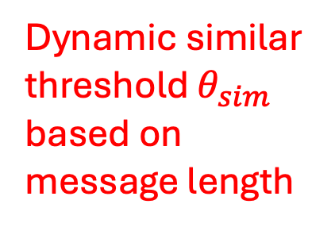

PIPLUP’s Parse Tree Structure
Dynamic similar threshold $θ_{sim}$ based on message length
Allows at most $θ_{br}$ events in one cluster

Slide 10
PIPLUP’s Parsing Process
Merge structurally similar templates
Dynamic constant token identification and allocation based on frequency

Slide 11
Research Questions
RQ1: How do different parameters impact PIPLUP?
Are PIPLUP’s default parameters generalizable?
RQ2: How does PIPLUP compare to state-of-the-art parsers in terms of parsing effectiveness?
RQ3: How does PIPLUP compare to state-of-the-art parsers in terms of parsing efficiency?

Slide 12
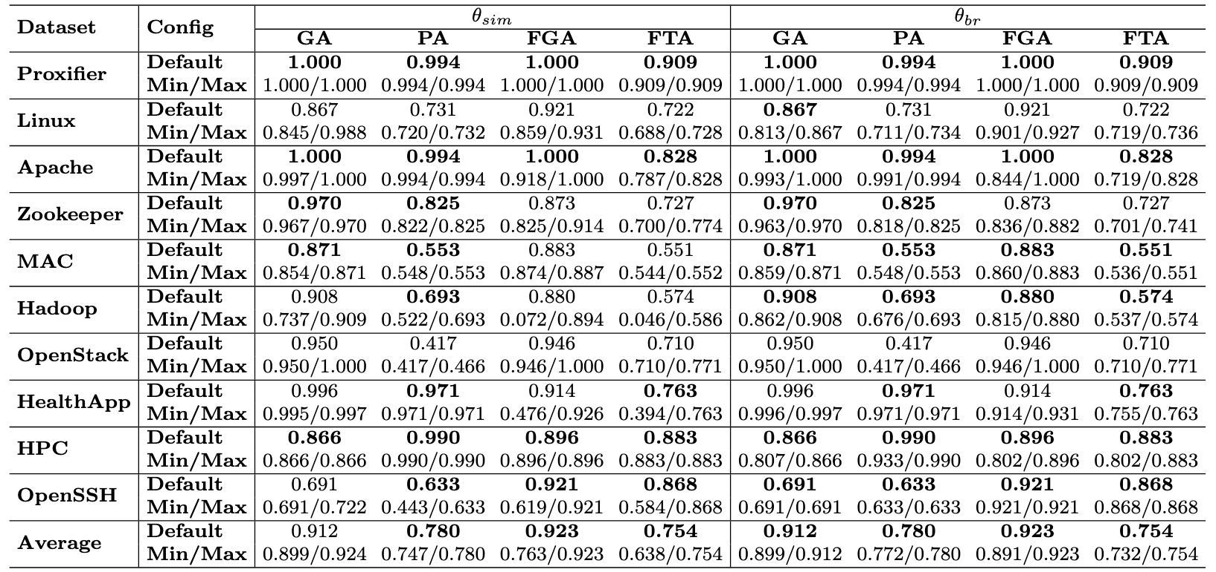
RQ1: Results
PIPLUP’s parameters are data-insensitive (default v.s. alternatives)
Notes:
The default setting performance, max and min value of GA, PA, FGA, and FTA achieved by PIPLUP with different settings on the 10 datasets. The maximum obtained by PIPLUP’s default settings (i.e., θsim = dynamic and θbr = 2) are highlighted with bold fonts.

Slide 13
RQ2 & 3: Results
PIPLUP has LLM-based-level effectiveness and Drain-level efficiency
Effectiveness
Efficiency
Parsing time (s)

Slide 14
Future Works
Implement PIPLUP in industrial log parsing pipelines
Study PIPLUP’s benefits for downstream tasks (e.g., anomaly detection)

Slide 15

Scan to Read My Paper
Q. Qin, X. Wu, H. Li, and E. Merlo, “Plug it and Play on Logs: A Configuration-Free Statistic-Based Log Parser,” submitted to Empirical Software Engineering (EMSE), 2025.

