Slide 1


Conditional Dynamic CFG Tracing
Feb 2, 2026
Ali Entezari

Slide 2

Story
John
C/C++ programmer
He loves vibe coding

Slide 3

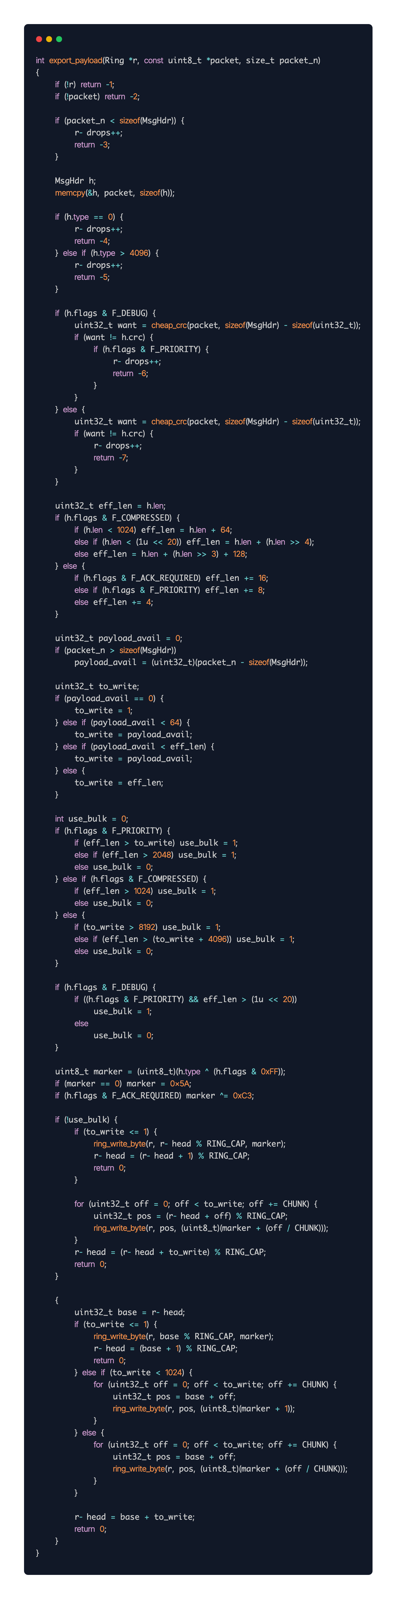

One day
Hey gpt, can you write a function for me that exports payload? The payload is just few MB of data
Sure!

Slide 4

6 months later…
Jane
C/C++ programmer

Slide 5


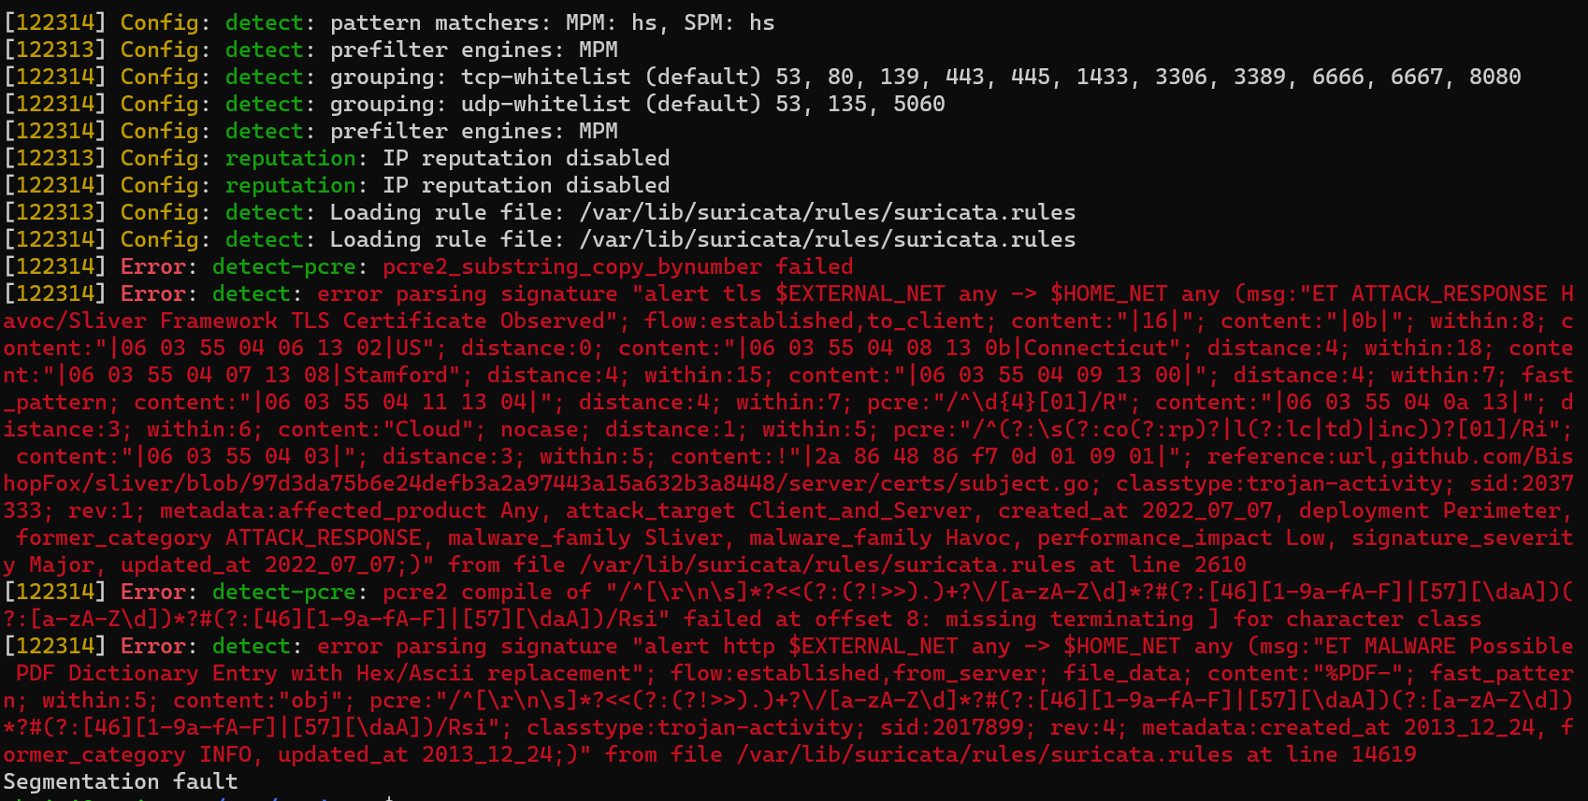
Segmentation Fault
The core file points to export_payload
Segmentation fault (core dumped)
4MB is Fine
8MB gives Error

Slide 6


Reading export_payload

Slide 7
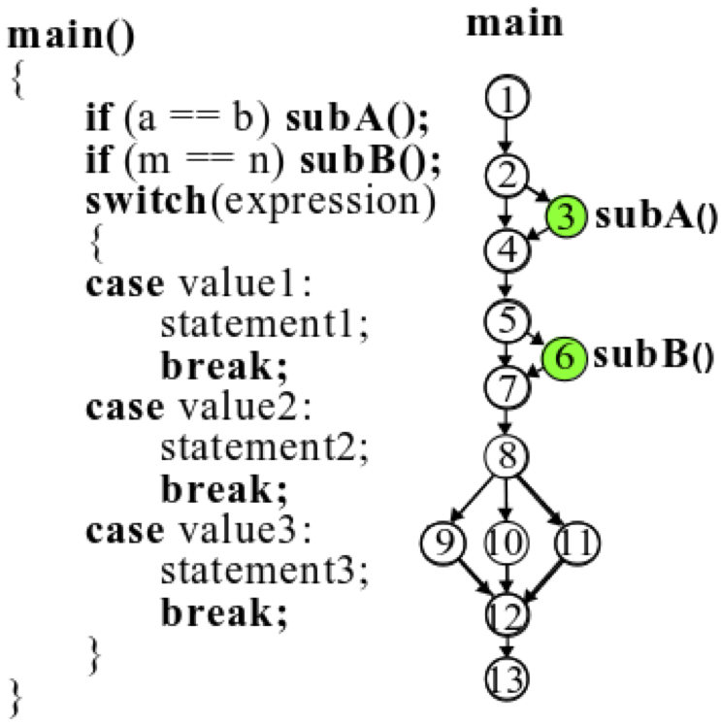
Control Flow Graph
Jane doesn’t have time to read john’s spaghetti code, She needs CFG

Slide 8


Control Flow Graph
Jane finds IntelPT for CFG
Unlucky for her, she has AMD. She must move the project to an Intel computer

Slide 9

Intel PT
A few minute Intel PT record = hundreds of GB!

Slide 10
Other Tools
DCFG-Trace: Dynamic CFG Trace by Intel
CFGgrind: A dynamic control flow graph (CFG) reconstruction plugin for valgrind.

Slide 11
Other Tools
Dynamic
DCFG-Trace: Dynamic CFG Trace by Intel
CFGgrind: A dynamic control flow graph (CFG) reconstruction plugin for valgrind.
dynamic
Unlike other CFG generators that are based on the static binary executable, dynamic is in runtime
Unlike other CFG generators that are based on the static binary executable, dynamic is in runtime

Slide 12
Other Tools
Complex API
Requires Coding!
Dynamic
DCFG-Trace: Dynamic CFG Trace by Intel
CFGgrind: A dynamic control flow graph (CFG) reconstruction plugin for valgrind.
dynamic
No control over what to record!
Unlike other CFG generators that are based on the static binary executable, dynamic is in runtime
Unlike other CFG generators that are based on the static binary executable, dynamic is in runtime

Slide 13
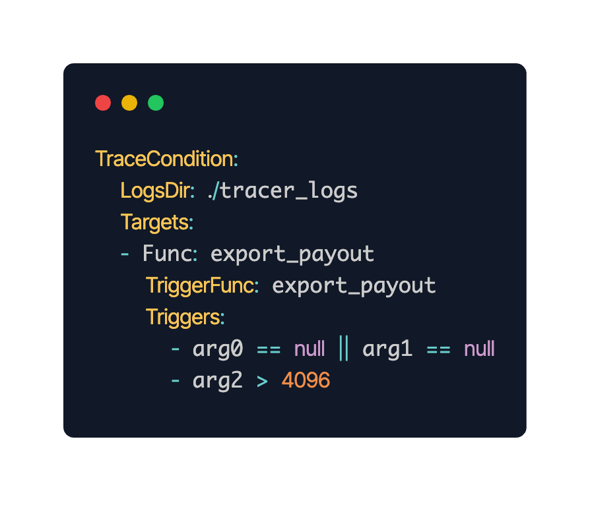
Conditional Dynamic CFG Tracer
Only 3 Steps!
Write config.yaml
Run program with LD_PRELOAD=tracer.so
Convert traces to DCFG in html

Slide 14


Conditional Dynamic CFG Tracer
Interactive DCFG in a html
Check DCFG file online
https://conditional-dcfg-trace.tiiny.site/

Slide 15
How does it work?
Works on top of LibPatch probes
2-layer probe strategy
Compiles conditions into AST nodes in runtime

Slide 16
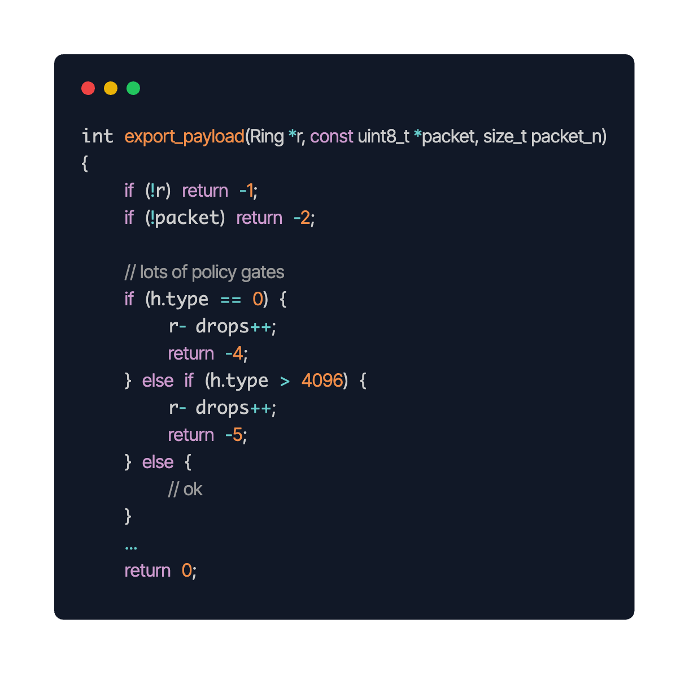
2-Layer Probe Strategy
Probe 1
Probe 2
Probe 2
Probe Type 1:
Attached to function entry and exit
Always enabled
Checks conditions
Enable or disable probe 2s
Probe Type 2:
Attached after every jump inside the function
Enabled if condition is met
Writes data on ring buffer
Probe 2
Probe 2
Probe 2
Probe 1

Slide 17
How does probe 1 check conditions?
if
Once at the beginning:
Reads the program dwarf file to understand argument types
Parses Config.yaml
Creates AST nodes for online condition check
Every time in probe 1:
Extracts args from registers (general purpose regs, xmm, stack)
Uses AST nodes for condition check
Enable or disable all Probe 2s
||
==
&&
arg0
null
>
==
arg1
10
arg2.head
null

Slide 18
Evaluation
SPEC 2017 bench test 505
“505.mcf_r is a benchmark which is derived from MCF, a program used for single-depot vehicle scheduling in public mass transportation. The program is written in C. The benchmark version uses almost exclusively integer arithmetic.”
Complex Control Flow

Slide 19
Speed Evaluation
MCF 505 (reference input) | Conditional DCFG Tracer | Intel PT (native) | Probe-1 overhead | Probe-2 overhead | price_out_impl
Only probe-1 is enabled to check condition (ready mode) | ~5 mins | ~5 mins | 33 calls Avg: 30 μs | 0 calls Avg: 0s | Avg time: 3.3 s
Probe-2 is always enabled on price_out_impl (worst case) | ~ 32 mins | ~5 mins | 33 calls Avg: 30 μs | 8.4B calls Avg: 90 ns | Avg time: 53.1s
1 probe-1: price_out_impl entry and exit
71 probe-2 : jumps inside price_out_impl (complex control flow)
When tracing, in ready mode has no impact 1x; the target function is 16x slower and the total runtime is 6x slower

Slide 20
Coverage Evaluation
MCF 505 (test input) | Conditional DCFG Tracer | Intel PT
Finding jumps | (107/107) 100% | 100%
Attaching probes to jumps in runtime | (91/107) 85% | 100%
Which jumps does it fail with?
Jumps exactly before ret
Jumps exactly before nop,nopl,nopw
Jumps exactly before another jump

Slide 21

Next Steps
Add Adaptive Controller (Auto mode)
Add system health trigger
Power up AI with Conditional DCFG Tracer for a more insightful debugging

Slide 22
Summary – Thanks for your attention!
Segmentation fault (core dumped)
Probe 1
Probe 2
Probe 2
Probe 2
Probe 2
DCFG file online
Probe 2
No impact 1x in Ready Mode
Hardware independent
Lower trace file size
Coverage 85%
6x slower on MCF 505 Worst case
Probe 1

