Slide 1
Using Topic Modeling to Find Most Important Log Lines
Vithor Bertalan
Robin Moine
Prof. Daniel Aloise
Polytechnique Montréal
DORSAL Laboratory

Slide 2
POLYTECHNIQUE MONTRÉAL
Research Parts
First step: Build log parser using the whole text
Results published in
Second step: Finding import log lines/symptoms
Third step: Finding causality between log lines
Using Topic Modeling to Find Most Important Log Lines– Vithor Bertalan , Robin Moine and Daniel Aloise
2/18 – dorsal.polymtl.ca

Slide 3
POLYTECHNIQUE MONTRÉAL
Step 1
First step: Parsing each of the log lines using the method from first step of the research, or Drain [1].
Variables are replaced, but are also stored in a separate table.
Using Topic Modeling to Find Most Important Log Lines– Vithor Bertalan , Robin Moine and Daniel Aloise
3/18 – dorsal.polymtl.ca

Slide 4
POLYTECHNIQUE MONTRÉAL
Step 2
First step: Converting raw log lines to mathematical arrays.
We did the first tests using Transformers, but decided to migrate to TFIDF.
Optional step to use RegEx.
Using Topic Modeling to Find Most Important Log Lines– Vithor Bertalan , Robin Moine and Daniel Aloise
4/18 – dorsal.polymtl.ca

Slide 5
POLYTECHNIQUE MONTRÉAL
Step 3
Creating a distance matrix, using Euclidian distance between the log lines. MinMax normalization [0-1] afterwards.
Size n (number of log lines) x n
Created to represent the distance between the terms.
Using Topic Modeling to Find Most Important Log Lines– Vithor Bertalan , Robin Moine and Daniel Aloise
5/18 – dorsal.polymtl.ca

Slide 6
POLYTECHNIQUE MONTRÉAL
Step 4
Creating a variable matrix, where each parsed Variable becomes a column inside the matrix.
Size n (log lines) x v (number of unique variables).
Created to carry the value of the parsed tokens.
Using Topic Modeling to Find Most Important Log Lines– Vithor Bertalan , Robin Moine and Daniel Aloise
6/18 – dorsal.polymtl.ca

Slide 7
POLYTECHNIQUE MONTRÉAL
Step 5
Applying Jaccard similarity distance to the variable matrix.
Equal lines will have a value of 1, lines with just one token of difference will have a value of 1 – (1/number of tokens), lines completely different will have 0.
Using Topic Modeling to Find Most Important Log Lines– Vithor Bertalan , Robin Moine and Daniel Aloise
7/18 – dorsal.polymtl.ca

Slide 8
POLYTECHNIQUE MONTRÉAL
Step 6
Creating a count matrix, where lines that appear close will have a high value.
Size n (number of log lines) x n
Created to give value to timeframes inside log files.
 | 1 | 2 | 3 | 4 | 5
1 | 1 | 0.75 | 0.5 | 0.25 | 0
2 | 0.75 | 1 | 0.75 | 0.5 | 0.25
3 | 0.5 | 0.75 | 1 | 0.75 | 0.5
4 | 0.25 | 0.5 | 0.75 | 1 | 0.75
5 | 0 | 0.25 | 0.5 | 0.75 | 1
Using Topic Modeling to Find Most Important Log Lines– Vithor Bertalan , Robin Moine and Daniel Aloise
8/18 – dorsal.polymtl.ca

Slide 9
POLYTECHNIQUE MONTRÉAL
Step 7
Weighting each of the matrices:
α is multiplied by the distance matrix
β is multiplied by the variable matrix
γ is multiplied by the count matrix
α + β + γ = 1, so that values are fixed between [0,1]
Using Topic Modeling to Find Most Important Log Lines– Vithor Bertalan , Robin Moine and Daniel Aloise
9/18 – dorsal.polymtl.ca

Slide 10
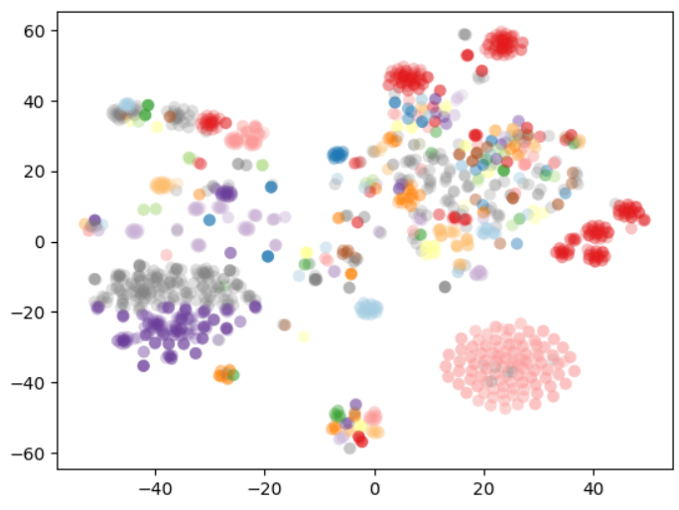
POLYTECHNIQUE MONTRÉAL
Step 8
Applying DBSCAN to cluster the resulting matrix.
Using Topic Modeling to Find Most Important Log Lines– Vithor Bertalan , Robin Moine and Daniel Aloise
10/18 – dorsal.polymtl.ca

Slide 11
POLYTECHNIQUE MONTRÉAL
Step 9
Ciena wants the key users to provide feedback on the cluster methods.
Therefore, our method needs to receive feedback: getting input from the users on which lines should be groupéd together (must-link constraints) and which ones should not be grouped together (cannot-link constraints).
Using Topic Modeling to Find Most Important Log Lines– Vithor Bertalan , Robin Moine and Daniel Aloise
11/18 – dorsal.polymtl.ca

Slide 12
POLYTECHNIQUE MONTRÉAL
Step 9
Now working on implementing a VNS (Variable Neighborhood Search) with K-Medoids to consider the cannot-link and must-link constraints. Based on the work of [2].
Current work on comparing found clusters, log templates and variables with the ones provided by Ciena.
Using Topic Modeling to Find Most Important Log Lines– Vithor Bertalan , Robin Moine and Daniel Aloise
12/18 – dorsal.polymtl.ca

Slide 13
POLYTECHNIQUE MONTRÉAL
Step 10
Using topic modeling for each of the clusters.
Topic modeling has been used succesfully for log files, such as in [3], [4].
State-of-the-art methods use Transformers. So as to make the method faster, so far, we are using LDA.
Using Topic Modeling to Find Most Important Log Lines– Vithor Bertalan , Robin Moine and Daniel Aloise
13/18 – dorsal.polymtl.ca

Slide 14
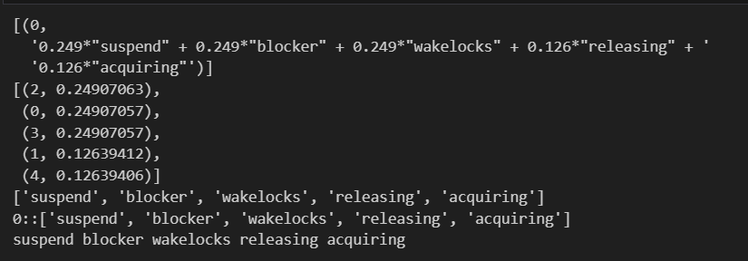
POLYTECHNIQUE MONTRÉAL
Step 10
Each cluster will have its most important words, as we are selecting just one topic:
Using Topic Modeling to Find Most Important Log Lines– Vithor Bertalan , Robin Moine and Daniel Aloise
14/18 – dorsal.polymtl.ca

Slide 15
POLYTECHNIQUE MONTRÉAL
Step 10
Ranking all the lines of the cluster, based on the shared tokens with the topic words.
The line with the most shared tokens is therefore considered as the most meaningful of the cluster.
Using Topic Modeling to Find Most Important Log Lines– Vithor Bertalan , Robin Moine and Daniel Aloise
15/18 – dorsal.polymtl.ca

Slide 16
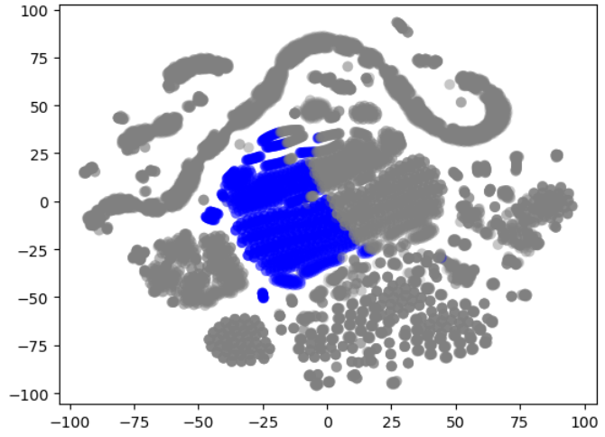
POLYTECHNIQUE MONTRÉAL
Step 10
Selecting a cluster:
Using Topic Modeling to Find Most Important Log Lines– Vithor Bertalan , Robin Moine and Daniel Aloise
16/18 – dorsal.polymtl.ca

Slide 17
POLYTECHNIQUE MONTRÉAL
Step 10
Selecting just the first topic using LDA:
['0.032*"directory" + 0.030*"no" + 0.029*"file" + 0.026*"such" + '0.023*"localdisk" + 0.021*"cannot" + 0.021*"error" + 0.020*"or" + '0.016*"cp" + 0.016*"ome“’]
Finding lines with the highest token similarity:
Using Topic Modeling to Find Most Important Log Lines– Vithor Bertalan , Robin Moine and Daniel Aloise
17/18 – dorsal.polymtl.ca

Slide 18
POLYTECHNIQUE MONTRÉAL
Step 10
This line if therefore chosen as the most significant of the cluster.
Current work on the feedback on clustering, and creating metrics to evaluate the method in the field of Log Summarization.
Using Topic Modeling to Find Most Important Log Lines– Vithor Bertalan , Robin Moine and Daniel Aloise
18/18 – dorsal.polymtl.ca

